Slide 1

Current And Upcoming Trends In
Data Analytics & Talk Abouts JD and Skills Required
Present By:
Neha Devmorari
Nirmala Bohra
Sandhya Rami

Slide 2

Introduction to Data Analytics
Data analytics is the process of extracting insights and knowledge from data to inform decision-making. It involves collecting, organizing, and analyzing data to uncover patterns, trends, and opportunities that can drive business growth and innovation.

Slide 3
Current Trends in Data Analytics
Big Data
Cloud Computing
Power BI
The exponential growth of data from various sources, such as social media, IoT, and e-commerce, has led to the rise of big data analytics.
Cloud-based data storage and processing platforms have made it easier to manage and analyze large datasets.
Analyze Data , Clean Data And Convert Data Into Visual Format. For Reports , Dashboards.

Slide 4
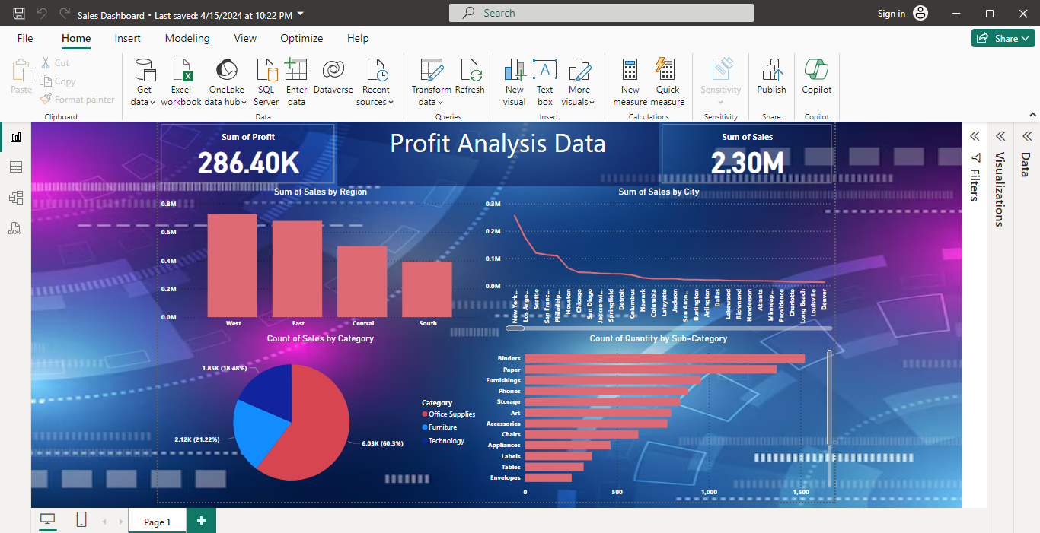
Why Power BI?
Search Volume
Maximum Feature
Data Connection
Open Source

Slide 5
The Future of Data Analytics: Emerging Trends and Innovations
Generative AI
Generative AI refers to a type of artificial intelligence that learns from large datasets and generates new content, such as images, text.
Internet of Things (IoT)
Analyzing real-time data from connected devices to enable predictive maintenance and optimized operations.
Edge Computing
Processing data closer to the source to enable faster decision-making and reduce latency.
Blockchain and Distributed Ledgers
Enhancing data integrity and transparency through decentralized, secure data management.

Slide 6

Introduction to the Role of Data Analyst
Data analysts play a crucial role in transforming raw data into actionable insights that drive business decisions. They leverage their expertise in data collection, analysis, and visualization to uncover trends, identify patterns, and provide data-driven solutions.

Slide 7
Job Description: Key Responsibilities
1
Data Collection
2
Data Analysis
Gathering and organizing data from various sources, ensuring data integrity and accuracy.
Performing statistical analysis, identifying trends, and deriving meaningful insights from the data.
3
Reporting and Visualization
4
Collaboration
Creating compelling data visualizations and reports to effectively communicate findings to stakeholders.
Working closely with cross-functional teams to understand business needs and provide data-driven solutions.

Slide 8
Technical Skills Required
Data Management
Statistical Analysis
Data Visualization
Proficiency in data extraction, transformation, and loading (ETL) processes using tools like SQL, Excel, and Python.
Expertise in statistical methods and the ability to interpret complex data patterns and trends.
Mastery of data visualization tools such as Tableau, Power BI, or Matplotlib to create impactful dashboards and reports.

Slide 9

Analytical and Problem-Solving Skills
1
Critical Thinking
Ability to approach problems from multiple angles and use data-driven insights to make informed decisions.
2
Attention to Detail
Meticulous approach to data analysis, ensuring accuracy and reliability of findings.
3
Creativity
Innovative mindset to identify new data sources and develop unique solutions to business challenges.

Slide 10



Communication and Presentation Skills
Effective Communication
Presentation Expertise
Collaborative Mindset
Ability to translate complex data insights into clear and compelling narratives for stakeholders.
Skilled in creating visually appealing and informative data visualizations to present findings.
Willingness to work closely with cross-functional teams and understand their data needs.

Slide 11
Educational and Experience Requirements
Education
Experience
Bachelor's degree in a quantitative field such as Statistics, Mathematics, or Computer Science.
1-3 years of experience in data analysis, business intelligence, or a related field.
Certifications
Continuing Education
Relevant data analysis or visualization certifications are a plus, such as Tableau, SQL, or Python.
A commitment to staying up-to-date with the latest data analysis trends and technologies.

Slide 12

Introduction to Data Analytics Company- Radhika
Enterprises(Fresher)
We are looking to hire a data analyst to join our data team. You will take responsibility for managing our master data set, developing reports, and troubleshooting data issues. To do well in this role you need a very fine eye for detail, experience as a data analyst, and a deep understanding of the popular data analysis tools and databases.

Slide 13
Data Analyst Job Posting
Responsibilities
Required Skills
Preferred Qualifications
Managing master data
Generating reports from single or multiple systems.
Troubleshooting the reporting database environment and reports.
Data Analysis
Data Bases
Statistic
Linear Algebra
Diploma
B . Tech/M . Tech/IT
BCA/MCA

Slide 14
Apac Business Times : Fresher
Responsibilities
Required Skills
Preferred Qualifications
- Strong analytical skills and
ability to work with large datasets
- Excellent communication and
presentation skills.
- Experience with data visualization
and reporting.
-
Data Analysis
Data Science
Problem Solving
Data Visualization
Applied Mathematics
- Bachelor's degree in Data Science, Statistics, Mathematics, or related field.

Slide 15
TCS: Mid-Senior Level
Responsibilities
Required Skills
Preferred Qualifications
Design and implementation of production code .
Expertise using Python or SAS · Expertise using SQL .
Experience using APIs.
Experience building data quality reports .
- Data Analysis using SQL, R or Python.
- Bachelor's or Master's degree in a quantitative field
In IT/Computer.
- Year of Experience- 6+ years.

Slide 16

Thank You

